Slide 1
Tutorial
Dr.-Eng. Igor B.Gurevich,
Vera Yashina
PROLEGOMENA TOWARD ALGEBRAIC IMAGE ANALYSIS
Dorodnicyn Computing Center, Russian Academy of Sciences
40 Vavilov str., Moscow , 119333, the Russian Federation.
Tel. (499)1358831, Tel./Fax (499)1359033.
e-mail: igourevi@ccas.ru, werayashina@gmail.com

Slide 2

Tutorial Contents
The purposes of this tutorial are:
to set forth the state of the art of mathematical theory of image analysis;
to consider the algebraic approaches and techniques acceptable for image analysis;
to present a methodology, mathematical and computational techniques for automation of image mining on the base of Descriptive Approach to Image Analysis (DAIA) and to consider an example (automated diagnosis of hematological deceases).
2 /140

Slide 3
Tutorial Contents
I. State of the art
II. The Algebraic Approaches and Techniques
IV. Descriptive Model of an Information Technology
III. Descriptive Approach to Image Analysis and Understanding
3 /140

Slide 4
Tutorial Contents
1. State of the art of mathematical theory of image analysis.
2. The Algebraic Approaches and Techniques in Image Analysis. Algebraization of Pattern Recognition (1970 – till now).
2.1 The Basic Theories
3. Descriptive Approach to Image Analysis and Understanding (DAIA) and its main tools
3.1 Descriptive Approaches – basic steps
3.2 DAIA
4. Descriptive Model of an Information Technology for Early Diagnostic Analysis of Cytological Specimens
3.3 Descriptive Image Models
4.1 Problem Set-up
4.2 Mathematical Means Used for Formal Representation of a Descriptive Model
4.3Discussion of the Results
2.2 Image Algebras
4 /140

Slide 5
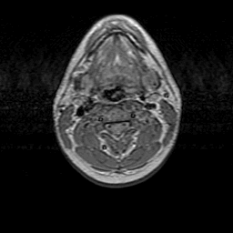
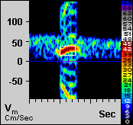

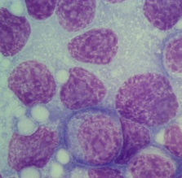
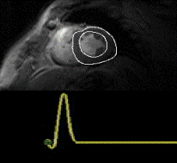

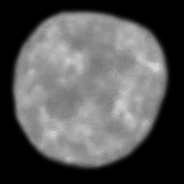
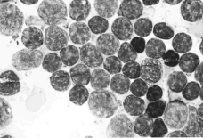

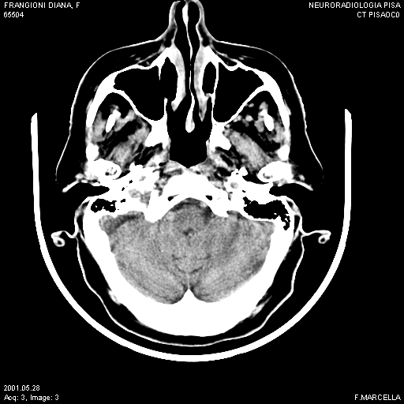
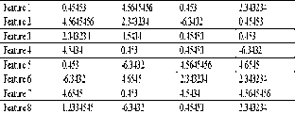
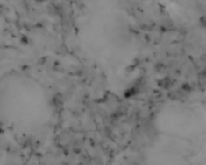
On a Way to a Unified Theory
Automation of Image Processing, Analysis, Estimating and Understanding
5 /140

Slide 6
On a Way to a Unified Theory
Image Analysis and Estimation (IAE) Problems
Balance
Goals and Tasks of a Problem Solving
Ways and Means of
An Image Acquisition
The Nature of Visual Perception
Mathematical, Computational and Technological Means Allowable for IAE
An Image Rendering
An Image Reproduction
An Image Formation
6 /140

Slide 7
On a Way to a Unified Theory
Purposes of Automation
To develop, adapt and check methods and algorithms of an image recognition, understanding and estimation
To choose optimal and appropriate methods and algorithms of an image recognition, understanding and estimation
To check a quality of initial data and their suitability for image recognition problems solving
To use standard algorithmic schemes of image recognition, understanding, estimation and retrieval.
7 /140

Slide 8
On a Way to a Unified Theory
The Mathematical Theory of Image Analysis
How? Way and Tools
Developing Stage
Implementation
Purposes
Interpretation
Algebraization
8 /140

Slide 9
On a Way to a Unified Theory
Algebraization Stages
Mathematical Morphology (G. Matheron, J. Serra [1970’s])
Zhuravlev’s Algebra (Yu. Zhuravlev [1970’s]
Pattern Theory (U. Grenander [1970’s]
Image Algebra (Serra, Sternberg [11400’s]
Standard Image Algebra (Ritter [1990’s])
Descriptive Image Algebras (Gurevich [1990-2000])
Descriptive Image Algebras (Gurevich, Yashina [2001->∞])
Theory of Categories Techniques (M.Pavel [11400’s])
9 /140

Slide 10
Tutorial Contents
1. State of the art of mathematical theory of image analysis.
2. The Algebraic Approaches and Techniques in Image Analysis. Algebraization of Pattern Recognition (1970 – till now).
2.1 The Basic Theories
2.2 Image Algebras
3. Descriptive Approach to Image Analysis and Understanding (DAIA) and its main tools
3.1 Descriptive Approaches – basic steps
3.2 DAIA
4. Descriptive Model of an Information Technology for Early Diagnostic Analysis of Cytological Specimens
3.3 Descriptive Image Models
4.1 Problem Set-up
4.2 Mathematical Means Used for Formal Representation of a Descriptive Model
4.3Discussion of the Results
10 /140

Slide 11
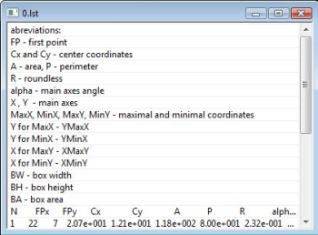



State of the art
Image Recognition. Classical Case
Selected
Algorithm
Raw Images
Solution
11 /140

Slide 12
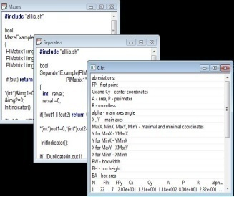
State of the art
Multiclassifiers. Zhuravlev’s Algebra.
Algorithms
Raw Images
Solution
12 /140

Slide 13


State of the art
Image Recognition. Reduction of Images to Models.
Some Class of Models
Selected
Algorithm
Raw Images
Image Models
Solution
13 /140

Slide 14



State of the art
Image Recognition. Classical Multimodel Case.
Plural Models
Selected
Algorithm
Raw Images
Image Models
Solution
14 /140

Slide 15
State of the art
Image Recognition. General Case (Multiclassifiers and Model Plurality)
Plural Models
Algorithms
Raw Images
Image Models
Solution
15 /140

Slide 16
State of the art
The Crucial Points in the Development of Image Analysis and Recognition
The understanding of the nature of initial data (images)
Methods for image representation and description that provide the construction of image models for image recognition problems
A mathematical language for a unified description of image models and their transformations ensuring the construction of image models and the solution of image recognition problems
Models for solving image recognition problems in the form of standard algorithmic schemes that in a general case ensure transitions from the original image to its model and from the latter to a desired solution
16 /140

Slide 17
State of the art
Algebraic Image Analysis
Image Representation Space
Language
Algorithmic Schemes
17 /140

Slide 18
Tutorial Contents
1. State of the art of mathematical theory of image analysis.
2. The Algebraic Approaches and Techniques in Image Analysis. Algebraization of Pattern Recognition (1970 – till now).
2.1 The Basic Theories
2.2 Image Algebras
3. Descriptive Approach to Image Analysis and Understanding (DAIA) and its main tools
3.1 Descriptive Approaches – basic steps
3.2 DAIA
4. Descriptive Model of an Information Technology for Early Diagnostic Analysis of Cytological Specimens
3.3 Descriptive Image Models
4.1 Problem Set-up
4.2 Mathematical Means Used for Formal Representation of a Descriptive Model
4.3Discussion of the Results
18 /140

Slide 19
The Algebraic Approaches and Techniques
Leading Approaches in the Mathematical Theory of Image Analysis Oriented for Automation of Image Analysis and Understanding.
Basic Theories
Pattern Theory
Theory of Categories Techniques in Pattern Recognition
Image Algebras
Standard Image Algebra
Descriptive Image Algebra
The Algebraic Approach
19 /140

Slide 20
The Algebraic Approaches and Techniques
Basic Theories
20 /140

Slide 21
The Algebraic Approaches and Techniques
Basic Theories
Pattern Theory of U.Grenander
Theory of Categories Techniques in Pattern Recognition of M.Pavel
The Algebraic Approach of Yu.Zhuravlev
21 /140

Slide 22
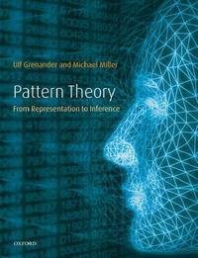
The Algebraic Approaches and Techniques
Pattern Theory (U.Grenander)
“Pattern Theory” (U.Grenander) – techniques for data representation and transformation on the base of regular combinatorial structures and algebraic and probabilistic means in pattern recognition.
“All science tries to discover patterns whether it is in nature or in the man made world. Often the pattern structure is far from obvious and it takes intellectual curiosity coupled with insight in the subject matter to discover the true pattern”.
http://www.dam.brown.edu/people/ulf/gpt.htm (Ulf Grenander ‘s Home Page)
U. Grenander . General Pattern Theory. A Mathematical Study of Regular Structure.- Clarendon Press, Oxford, 1993.
22 /140

Slide 23
The Algebraic Approaches and Techniques
Pattern Theory (U.Grenander)
The Main Idea
Knowledge about patterns should be represented in the terms of regular structures*
Main Features of Pattern Theory
Atomism
Combinatority
Observability
* Regular structures are structures constructed by precise rules.
23 /140

Slide 24
The Algebraic Approaches and Techniques
Pattern Theory (U.Grenander)
Atomism
Structures construction from several basic elements;
Combinatority
Construction of precise rules of definition of legal and illegal structures;
Observability
Search of identification rules for definition of equivalence classes.
The main question is how one element of structure could take place of another one without structure changing in common.
Pattern theory approach to construction of such rules begins from realization of quality rules and follows with realization of quantity rules.
Pattern theory describes technique of such rules definition.
24 /140

Slide 25
The Algebraic Approaches and Techniques
Pattern Theory (U.Grenander)
Pattern Theory
the most common approach to algebraic description of information;
construction of an observed patterns model by applying constraints to the model but not to the tools of patterns processing;
the main property of patterns is regularity;
the rule of pattern identification allows to consider a pattern with significant for the task detailing;
investigation of patterns by algebra, topology, probability theory and statistic hypothesizes.
25 /140

Slide 26
The Algebraic Approaches and Techniques
Adaptation to image processing, analysis and recognition tasks
Pattern algebra
Pattern topology
Pattern dynamics
“images"
Algebra homomorphisms
Algebra representations
Metric theory
Entropy
Stochastic relaxation
Markov processes
Pattern deformation
Pattern derivation
Connectors
26 /140

Slide 27
The Algebraic Approaches and Techniques
Theory of Categories Techniques in Pattern Recognition (M.Pavel)
“Theory of Categories Techniques in Pattern Recognition” (M.Pavel) – formal descriptions of pattern recognition algorithms via transforms of initial data preserving its class membership.
Pavel, M. Pattern Recognition Categories // Pattern Recognition, 1976, Vol.8, No.3, pp. 115-118.
Pavel, M. Fundamentals of Pattern Recognition, New York, Marcell Dekker, Inc., 11409.
27 /140

Slide 28
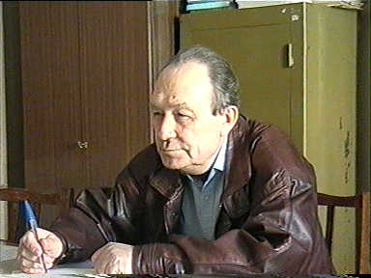
The Algebraic Approaches and Techniques
The Algebraic Approach to Recognition, Classification and Forecasting Problems (Yu.Zhuravlev)
“The Algebraic Approach to Recognition, Classification and Forecasting Problems” (Yu.Zhuravlev) – mathematical set-up of a pattern recognition problem, correctness and regularity conditions, multiple classifiers.
http://www.ccas.ru/personal/zhuravlev.html (Zhuravlev’s personal page)
28 /140

Slide 29
The Algebraic Approaches and Techniques
The Algebraic Approach of Yu.Zhuravlev
Algebra of Algorithms
methodic base for formalized representation of image recognition algorithms in terms of algebras over set of some basic algorithms;
theorem of existence of algorithm, which solves the problem, in the supplemented set of heuristic algorithms satisfied some simple properties;
with additional limitations on the classes of solvable problems and sets of heuristic algorithms it was shown a way of search of this correct algorithm;
idea of classifiers combination by algebraic correction.
29 /140

Slide 30
The Algebraic Approaches and Techniques
Image Algebras
30 /140

Slide 31
The Algebraic Approaches and Techniques
Image Algebras
Standard Image Algebra of G.Ritter
Descriptive Image Algebra of I.Gurevich
Image Algebra of S.Sternberg
31 /140

Slide 32
Notion “An Algebra”
World of Algebras
Up-to-Date Algebra
Algebraic System
Homogeneous and heterogeneous algebra
Graded Algebra, Z₂ – Graded Algebra (Superalgebra),
Exterior Algebra (Grossman Algebra)
Σ-operator Ring,
Quasi-group (semi-group)
Module
Lie Algebra
Full Matrix Ring
Algebra of Quaternions
Banakh algebra
Algebra of Functions (Dirikhle Algebra)
…
32 /140

Slide 33
Notion “An Algebra”
Prehistory of Algebra
An algebra is a part of mathematics concerned with investigation of algebraic operations.
Arithmetic operations over natural and positive rational numbers;
«Arithmetic» Diophant (3d c. AD )
Notion “An Algebra” – Muhhamed Al-Horesmi «Aldgebr al-mukabala» (9th c.);
Signs «+», «-», radical sign, power sign, brackets (the end of 15th c.);
F.Viete - symbolic notations of unknown values (the end of 16th c.);
Up-to-date algebraic symbolics (middle of 17th c.).
33 /140

Slide 34
Notion “An Algebra”
Development of Algebra
19th c.: investigation of arbitrary algebraic operations: a) 1st attempt to axiom investigation of algebraic operations - “Relations theory” of Euclid; b) composition of binary quadratic forms (K.Gauss); c) multiplication of substitutions (P.Ruffini and A.Cauchy) ; d) investigation of complex numbers; e) logic algebra of G.Boole; f) exterior algebra of H.Grassmann; g) quaternions of W.Hamilton; h) matrix calculation of A. Cayley; i) groups of substitutions (C.Jordan);
End of 19th c.-20 c.: D.Hilbert, E.Steinitz, E.Artin, E.Noether and B.L. van der Waerden “Up-to-date algebra”.
34 /140

Slide 35
Notion “An Algebra”
Development of Algebra
17th-18th c.: an algebra is a science about letter calculation-identity substitution of letter formulas, decision of algebraic equations (letters are integer and fractional numbers), “Introduction to algebra” (L.Euler);
18th-19th c.: an algebra is an algebra of polinomials: a) equations of 1st and 2d degrees; b) 16 c.: Kardano - 3d degrees, Ferrari – 4th degrees; c) 17 c.: A.Girard –a theorem about existence of complex radical for arbitrary algebraic equiation with complex coefficients; d) 18 c.: C.Gauss – strict proof; e) 1824: N.Abel – equations of more than 4th degrees in common view are not solvable; f) 1830: E.Galois – common criteria of solvability of algebraic equations in radicals (Theory of Galua);
18th-19th c.: theory of system of algebraic equations with several unknown values (Matrix algebra);
35 /140

Slide 36
Notion “An Algebra”
Main Branches of Algebra
Groups; semi groups, quasi-groups and loupes
Rings and fields, associative rings and algebras, nonassociative rings and algebras
Lattices (algebra with two types of operations)
Linear (vector) spaces
G. Birghoff algebras
A.I.Maltcev and A.Tarcki – theory of Models (sets with defined relations); Algebraic Systems
Topological Algebra
Algebra Lee
Normed Ring
Differential Algebras
Up-to-Date algebras
36 /140

Slide 37
Notion “An Algebra”
Group, Quasi-group, Loupe, Semi group, Module
Non-empty set G of any elements is called Group, if for any a, b,c from G following conditions are given: 1) Composition Law: a·b=b ·a; 2) Associative Law: (a·b)·c=a·(b·c); 3) Existence of left unit element e: e·a=a; 4)Existence of at least one (left) inverse element a⁻¹ from G: a·a⁻¹=e.
If instead of multiplication operation is given addition operation then group is called additive group. If the commutative law is given a·b=b·a then group is called Abel group.
Quasi-group is a set with one binary operation (which is called multiplication), in which both equations a∙x=b and y∙a=b have single decision for any elements a, b from this set. Quasi-group with unit is called loupe.
Semi Group is a set with one binary operation with given associative law.
Module is group with the operator ring.
37 /140

Slide 38
Notion “An Algebra”
Up-to-Date Algebra
An algebra is a ring U - a finite vector space - over some field P.
B. L. van der Waerden, Algebra I (Springer, Berlin, 1971); Algebra II (Springer, Berlin, 1967; Nauka, Moscow, 1976).
Properties of field P(α, β, γ∈Ρ)
1) ∀α, β ∈ P, ∃! (α+β) ∈ P: a) α+(β+γ) = (α+β)+γ; b) α+β = β+α; c) ∃0∈Ρ,∀α∈Ρ,α+0=α; d) ∀α∈Ρ,∃(−α), α+(−α)=0;
2) ∀α, β ∈ P, ∃! (αβ) ∈ P: a) α(βγ)=(αβ)γ; b) αβ=βα; c) ∃1∈Ρ, ∀α∈Ρ,1α=α; d) α(β+γ) = αβ+αγ.
Properties of ring U(a, b, c ∈U)
1) ∀a, b ∈ U, ∃! (a+b) ∈ U: a) a+(b+c) = (a+b)+c; b) a+b = b+a; c) ∃0∈U,∀a∈U,a+0=a; d) ∀a∈U,∃(−a), a+(−a)=0
2) ∀a, b ∈ U, ∃! (ab) ∈ U: a) a(bc)=(ab)c;
3) (αa+βb)c = αac+βbc
Properties of vector space(∀ α ∈P, a ∈U: αa ∈U)
1) α(βa)=(αβ)a; 2) (α+β)a = αa+βa; 3) α(a+b) = αa+ αb.
38 /140

Slide 39
Notion “An Algebra”
Birkhoff and Lipson Algebra
An algebra is a system A=[F] in which:
Φ = {S_{i}} is a family of non-void set S_{i} of different types of elements, each called a phylum of the algebra A.
The phyla S_{i} are indexed by some set I; i.e., S_{i}∈Φ for i∈I. F={f_{α}} is a set of finitary operations, where each f_{α} is a mapping f_{α}: S_{i(1, α)}x S_{i(2, α)}x…xS_{i(n(α), α)}→S_{r(α)} for some non-negative integer n(α), function i_{α}: k→ i(k, α) from n(α)={1,2,…, n(α)} to I and r(α)∈I. The operations f_{α} are indexed by some set Ω, i.e., f_{α}∈F for α∈Ω(or are called by appropriate names).
An algebra which has only one phylum will be called a homogeneous algebra; an algebra having more than one phylum, a heterogeneous algebra.
39 /140

Slide 40
Notion “An Algebra”
Algebraic System
(A.I. Maltzev) Algebraic System is an object A = <A, O, R>, consisting of non-empty set А, of a set O of algebraic operations o_{i} and of a set R of relations r_{j} on the set А.
Algebraic System
Universal Algebra
Relational System (or Model)
40 /140

Slide 41
Notion “An Algebra”
Graduated Algebras
Graduated Algebra is an algebra А which additive group represented as (weak) direct sum of group A_{i}, i=0,1,2…, where A_{i}A_{j} A_{i+j} for any i, j.
Example of Graduated Algebra: an algebra A=F[x] of polynomials over field F where A_{i} is a subspace generated by monomials with power i (A₀=F), i=1,…,n. A= .
Superalgebra is Z₂–graduated algebra, that is superspace A over field K with even linear mapping A⊗A→A.
Superspace is a vector space over field K with Z₂ – calibration .
41 /140

Slide 42
Notion “An Algebra”
World of Algebras
Exterior Algebra (Grossman Algebra) of vector space V over field K is an associative algebra over K with operation , which generated elements are e₁,…,e_{n}, where e₁,…,e_{n} is a base of space V, and following identifies are fixed:
Σ-operator ring, or ring with area of operators Σ is a ring with multiplication of ring elements by elements of some fixed set Σ (extended composition law):
(a+b)∙α = a∙α+b∙α (1)
(a∙b)α=(a∙α)∙b=a∙(b∙α) (2)
where α is an element of set Σ, and a, b, a∙α, b∙α are elements of ring.
Σ-operator ring could be considered as universal algebra with two binary operations (addition and multiplication) and with set Σ of unary operations linked by ordinary ring identifies and identifies (8), (9).
42 /140

Slide 43
Notion “An Algebra”
World of Algebras
Lee Algebra is unitary k-module L over commutative ring k with identity, bilinear mapping (x,y)→[x,y] of direct product L×L to L and following properties:
[x,x]=0 ([x,y]=-[y,x]);
[x,[y,z]]+[y,[x,x]]+[z,[x,y]]=0 (Identity of Jacob).
Lee Algebra is called commutative if [x,y]=0 for all x,y ∈ L.
Full Matrix Ring is a ring of all quadratic matrixes of fixed order over ring R.
R is an associative ring with identity.
Quaternion Algebra is four-dimensional algebra over field R with base 1, i, j, k.
43 /140

Slide 44
World of Algebras
Algebra in the sense of Birkhoff and Lipson
Heterogeneous algebra
Homogeneous algebra or
Algebraic system
Graded algebra
Super algebra
Universal algebra
Σ – operator ring
No operator ring
Over any ring Σ
Over field Σ
One binary
operation
Two binary
operation
Linear
algebra
Over field
R
Over field
C
Over field K
44 /140

Slide 45
Image Algebras
The History of “Image Algebras”
S. Sternberg (the first to use the term “image algebra” )
G.Matheron, J.Serra, S.Sternberg (a coherent algebraic theory specifically designed for image processing and image analysis - mathematical morphology)
H. Minkowski and H.Hadwiger (pixel neighborhood arithmetic and mathematical morphology)
A. Rosenfeld (digital topology)
M. Duff, D. Watson, T. Fountain, and G. Shaw (a cellular logic array for image Processing)
J.von Neumann, S.Unger (studies of interactive image transformations in cellular space)
45 /140

Slide 46
Image Algebras
The History of “Image Algebras”
L. Davidson (completed the mathematical foundation of mathematical morphology by formulating its embedding into the lattice algebra known as Mini-Max algebra)
P. Maragos (introduced a new theory unifying a large class of linear and nonlinear systems under the theory of mathematical morphology)
G.Ritter (Image Algebra)
I..B. Gurevich (Descriptive Image Algebra)
T.R. Crimmins and W.M. Brown, R.M. Haralick, L. Shapiro, R.W. Schafer, J. Goutsias, L. Koskinen and Jaako Astola, E.R. Dougherty , P.D. Gader, M.A. Khabou, A. Koldobsky, B. Radunacu, M.Grana, F.X. Albizuri, P. Sussner (recent papers in mathematical morphology and image algebras)
46 /140

Slide 47
Mathematical Morphology
Basic Operations
Closing
Opening
Erosion
Dilation
Additional Operations
Hit or Miss Transforms
Black Top-Hat
White Top-Hat
. . .
47 /140

Slide 48
Mathematical Morphology
Applications of Mathematical Morphology
Filtration
Segmentation
Construction of Image Representation Suitable for Recognition
Edge detection
Skeleton Extraction
Preliminary Shape Analysis
Feature Extraction
48 /140

Slide 49
Mathematical Morphology
Limitations
Choosing of a specific sequence of morphological operations and structuring elements.
Morphological methods have some well-known limitations.
For example, such fairly common image processing techniques as feature extraction based on convolution, Fourier-like transformations, chain coding, histogram equalization transforms, image rotation, and image registration and rectification are — with the exception of a few simple cases — either extremely difficult or impossible to express in terms of morphological operations.
The failure of a morphologically based image algebra was demonstrated by P.Miller:
(1) P. Miller. Development of a mathematical structure for image processing// optical division tech. report, Perkin-Elmer, 11403
49 /140

Slide 50
Image Algebra of S. Sternberg
Definition
Definition 3. Image Algebra (IA) is a formulation of cellular computer image processing algorithms into algebraic expression whose variables are images and whose operations logically or geometrically combine images (S.R. Sternberg).
A key step in mathematical morphology development was Sternberg generalization. He demonstrated that morphological operations could be applied both to binary and grey scale images.
As the base created by set theory Minkovsky operations of addition and subtraction is limited it is impossible to construct a universal theory for image processing on the base of morphological image algebra.
It is known that the limitation of the base are: 1) complexity of image processing operation implementation; 2) impossibility to establish a correspondence between mathematical morphology operations and linear algebra operations; 3) impossibility to apply mathematical morphology for transformations between different algebraic structures, in particular, between set including a real and complex numbers and vectors.
50 /140

Slide 51
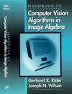
Standard Image Algebra of G.Ritter
Standard Image Algebra (G.Ritter)
Standard Image Algebra by G.Ritter – a unified algebraic representation of image processing and analysis operations.
Ritter, G.X., Wilson, J.N.: Handbook of Computer Vision Algorithms in Image Algebra, 2-d Edition. CRC Press Inc. (2001)
Ritter, G.X., 2001. Image Algebra. Center for computer vision and visualization, Department of Computer and Information science and Engineering, University of Florida, Gainesville, FL 32611.
http://www.cis.ufl.edu/~jnw/IA/ia-theory.html (Image Algebra. Theoretical Advances)
51 /140

Slide 52
Standard Image Algebra of G.Ritter
Definition
Image algebra is a heterogeneous or many-valued algebra in the sense of Birkhoff and Lipson with multiple sets of operands and operators.
Manipulation of images for purposes of image enhancement, analysis, and understanding involves operations not only on images, but also on different types of values and quantities associated with these images. Thus, the basic operands of image algebra are images and the values and quantities associated with these images (it is postulated that an image consists of two things, a collection of points and a set of values associated with these points).
The main operands of image algebra are images and templates.
52 /140

Slide 53
Standard Image Algebra of G.Ritter
Operands
Let F be a set of values and X be a set of points. An F-valued image on X is any element of F^{X} (i.e., a: X→F):
I = {(x, a(x)), x ∈ X, a(x) ∈ F}.
A template is an image whose pixel values are images (functions). In particular, an F-valued template from Y to X is a function t : Y→ F^{X}. Thus t is F^{X}-valued image on set Y.
Template operations play a dominant role in most algorithms and provide for brevity of code. The notion of a template, as used in image algebra, unifies and generalizes the usual concepts of templates, masks, windows, and neighborhood functions into one general mathematical entity. In addition, templates generalize the notion of structuring elements as used in mathematical morphology.
53 /140

Slide 54
Standard Image Algebra of G.Ritter
Operations
Operations on images:
Induced Operations on Images
Induced Unary Operations and Functional Composition
Binary Operations Induced by Unary Operations
Functional Specification of Image Operations
Multi-Valued Image Operations
54 /140

Slide 55
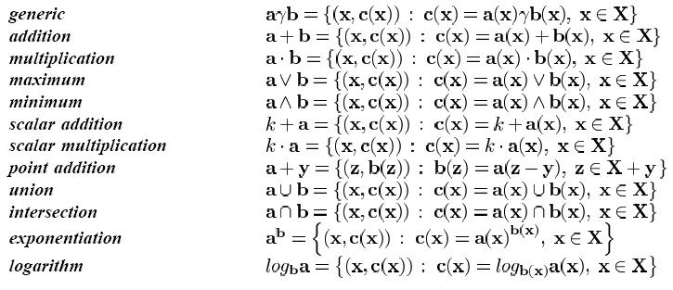
Standard Image Algebra of G.Ritter
Operations
The most significant operations (Binary Image Operations):
55 /140

Slide 56
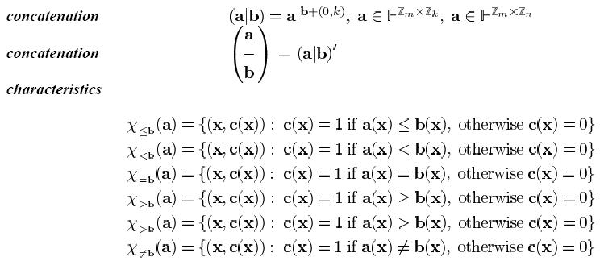
Standard Image Algebra of G.Ritter
Operations
The most significant operations (Binary Image Operations):
56 /140

Slide 57
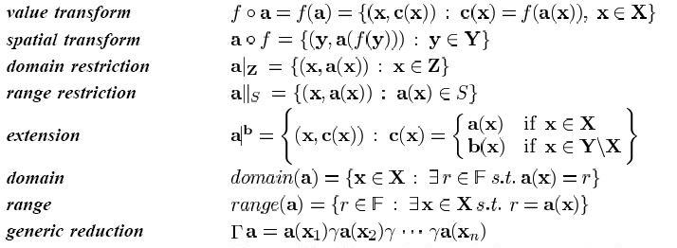
Standard Image Algebra of G.Ritter
Operations
The most significant operations (Unary Image Operations):
57 /140

Slide 58
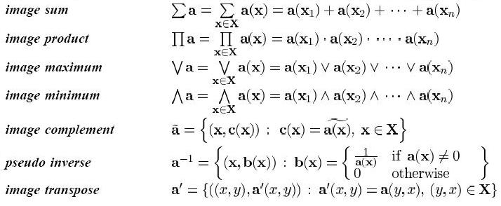
Standard Image Algebra of G.Ritter
Operations
The most significant operations (Unary Image Operations):
58 /140

Slide 59
Standard Image Algebra of G.Ritter
Operations
Operations on Images and Templates
Image-Template Products
Binary and Unary Template Operations
Recursive Template Operations
Image-Neighborhood Products
59 /140

Slide 60
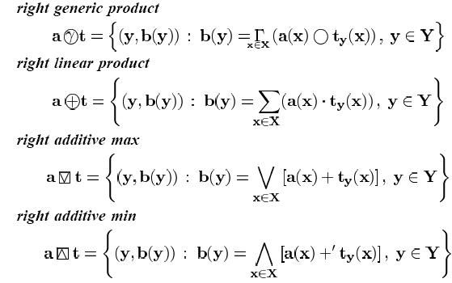
Standard Image Algebra of G.Ritter
Operations
The most significant operations (Image-Template Products):
60 /140

Slide 61
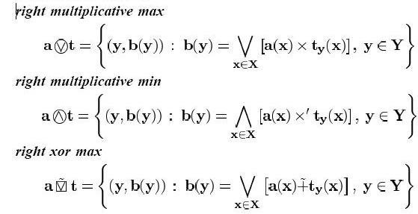
Standard Image Algebra of G.Ritter
Operations
The most significant operations (Image-Template Products):
61 /140

Slide 62
Standard Image Algebra of G.Ritter
Standard Image Algebra and Linear Algebra
Statement 1. A generalized convolution of two templates corresponds to matrix multiplication and convolution of an image and a template corresponds to application of a matrix to a vector.
Statement 2. A template t could be expanded into a sum or represented as a generalized convolution of others templates by an expansion of a corresponding matrix. This possibility is a base for application a standard image algebra for parallel image processing.
The statements 1, 2 establish relationship between template and a linear algebra and images of standard image algebra and a linear algebra.
It is proved that it is possible to link:
Invariant templates and Toeplitz matrixes
Cyclic templates and Cyclic matrixes.
62 /140

Slide 63
Standard Image Algebra of G.Ritter
Applications of Standard Image Algebra
Image Enhancement Techniques
Edge Detection and Boundary Finding Techniques
Thresholding Techniques
Thinning and Sceletonizing
Connected Component Algorithms
Morphological Transforms and Techniques
Pattern Matching and Shape Detection
Image Features and Descriptors
63 /140

Slide 64
Standard Image Algebra of G.Ritter
Edge Detection on Images by Discrete Differential
Let a ∈ R^{X} is a raw image. Image with extracted edges is b ∈ R^{X} and it could be getting by methods of differential (for any point of image definition domain):
1. Horisontal Differential:
b(i, j) = a(i,j)-a(i,j+1) или b(i,j) = 2a(i,j)-a(i,j-1)-a(i,j+1).
2. Vertical Differential:
b(i,j) = a(i,j)-a(i+1,j) or b(i,j) = 2 a(i,j)-a(i-1,j)-a(i+1,j).
3. Gradient Approximation:
b(i,j) = |a(i,j)-a(i+1,j)|+|(a(i,j)-a(i,j+1)| or b(i,j) = |a(i,j)-a(i+1,j+1)|+|a(i-1,j)-a(i,j+1)|.
64 /140

Slide 65
Standard Image Algebra of G.Ritter
Interpretation of Edge Detection Extraction by Means of a Standard Image Algebra
Horizontal Differential:
b:=a⊕r, where an invariant template r is defined as r_{(i,j)}(x)=
or b :=a⊕s, where s_{(i,j)}(x)=
r = | 1 | -1 |  | S = | -1 | 2 | -1
65 /140

Slide 66
Standard Image Algebra of G.Ritter
Interpretation of Edge Detection Extraction by Means of a Standard Image Algebra
2. Vertical Differential:
b:=a⊕t, where template t is defines as t_{(i,j)}(x)=
or
b:=a⊕u, where u_{(i,j)}(x)= .
 | -1
u = | 2
 | -1
t = | 1
 | -1
66 /140

Slide 67
Standard Image Algebra of G.Ritter
Interpretation of Edge Detection Extraction by Means of a Standard Image Algebra
3. Gradient Approximation:
b:=|a⊕t|+|a⊕r| or b:=|a⊕v|+|a⊕w|, where templates t and r are defined above, and v,w are defined as
v_{(i,j)}(x)=
and
w_{(i,j)}(x)=
V = | 1 |  |  | w = |  | -1
 |  | -1 |  |  | 1
67 /140

Slide 68
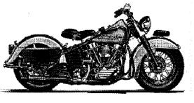
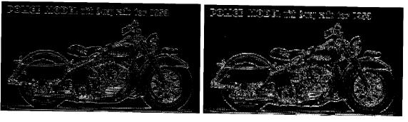
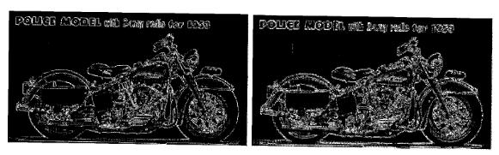
Standard Image Algebra of G.Ritter
Figure 1. Initial Image
Figure 2. Vertical differencing: left |a⊕t|, right |a⊕u|
Figure 3. Gradient approximation: left |a⊕t|+|a⊕r|, right |a⊕v|+|a⊕w|
68 /140

Slide 69
Standard Image Algebra of G.Ritter
Conclusions
Image Algebra is the most detailed of known approaches to an image operations description by means of algebraic operations over basic operations with simple structure.
Image Algebra includes standard local image analysis methods and mathematical morphology and it provides the following advantages:
allows to work with real and complex values;
allows to include as raw data scalar and vector data;
provides links of Image Algebra and Linear Structures;
provides more detailed and full descriptions of its operands and operations;
5) complex operations of image processing are divided into parallel simple operations.
69 /140

Slide 70
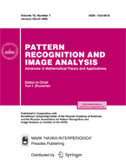
Descriptive Image Algebras
Descriptive Image Algebra (I.Gurevich)
Descriptive Image Algebra by I.Gurevich – a unified algebraic language for describing, performance estimating and standardizing algorithms for image analysis, recognition and understanding.
Gurevich, I.B., Yashina, V.V., Descriptive Image Algebras with One Ring, Pattern Recognition and Image Analysis: Advances in Mathematical Theory and Applications, Vol. 13, No.4., 2003, pp. 579-599.
Gurevich, I.B., Yashina, V.V., Operations of Descriptive Image Algebras with One Ring. In Pattern Recognition and Image Analysis: Advances in Mathematical Theory and Applications. Pleiades Publishing, Inc. 2006. - Vol.16, No.3. - P. 2140-328.
70 /140

Slide 71
Descriptive Image Algebras
Purposes
The requirements to a desirable language to write algorithms of image processing and recognition based on algebraic techniques are as follows- a new algebra must provide processing of:
images as objects of analysis and recognition;
image models – any formal representation of images, which are objects or results of analysis and recognition;
basic models of image recognition procedures.
71 /140

Slide 72
Descriptive Image Algebras
Definition
Descriptive Image Algebra is an algebra which basic operands are either the models of images (including images themselves and the values and quantities associated with these images), or operations on images, or both the models and the operations.
DIA Operands
Image Models
Operations on Images
Image Models and Operations on Images
72 /140

Slide 73
Descriptive Image Algebras
Requirements to Descriptive Image Algebra
Algebraic Language (Descriptive Image Algebras):
provide effective representation of descriptive image models;
provide representation of descriptive image models as elements of information technologies of image analysis, recognition and understanding;
provide generation of basic classes of descriptive image models (P-, G-, T-, I- models);
satisfy the main requirements and conditions determining algebraic constructions.
73 /140

Slide 74
Descriptive Image Algebras
Descriptive Image Algebra with One Ring
A ring U - a finite vector space - over some field P is descriptive image algebra with one ring if its operands are either image models either operations on images.
DIA with One Ring Operands
Image Models (Including Raw Images)
Image Transforms
DIA with One Ring Operations
Image analysis and processing transforms
Standard algebraic operations
Linear combinations and superpositions of these operations.
74 /140

Slide 75
Descriptive Image Algebras
Applications of Descriptive Image Algebra
DIAs are used for description of image-mining oriented problems, objects and transforms.
In construction of algorithmic scheme for formal description of processing, analysis and recognition based on DIA each elements of the scheme and any transform are defined as structures constructed by application of DIA operations to a set of DIA operands.
Early Diagnostic Analysis of Cytological Specimens
Automatic Extraction of
Dopaminergic Neuron Terminals on Striatum
Frontal Section Images
75 /140

Slide 76
Descriptive Image Algebras
The Technique for DIA with One Ring Construction
Step 1
To select field for algebra defining
Step 2
To specify operands of a set considered as candidate for DIA with one ring
Step 3
To specify operations of a set considered as candidate for DIA with one ring
Step 4
Step 5
To select addition operation, multiplication operation and multiplication by field element from specified operations of a set on step 3
To investigate interpretation of selected operations in image analysis and processing context
76 /191

Slide 77
Descriptive Image Algebras
The Technique for DIA with One Ring Construction
Step 6
To introduce necessary limitations on selected field, operands and operations (steps 1-4).
To formulate and prove a theorem of existence of such kind DIA with one ring . The proving is based on the necessary and sufficient conditions of DIA with one ring generation.
Step 7
77 /191

Slide 78
Descriptive Image Algebras
Construction of an Image Model
78 /140

Slide 79
Descriptive Image Algebras
Descriptive Image Model Construction by Descriptive Image Algebra
DIA with One Ring Operands and Operations
Image realizations Algebraic operations from a set of image transformations
Transformations of image realizations Algebraic operations introduced on a set of transformations
Image representations Algebraic operations introduced on a set of image representations
Image Models Algebraic operations introduced on a set of image models
79 /140

Slide 80
Descriptive Image Algebras
Descriptive Image Model Construction by Descriptive Image Algebra
Admissible image transformations
Parametric Transformations
Procedural Transformations
Generating Transformations
80 /140

Slide 81
Descriptive Image Algebras
DIM Construction by DIA
Algebra Operands | Algebra Operations | Result of Applying
Image realizations | Algebraic operations from a set of procedural transformations | Image realizations and procedural DIM
Procedural image transformations | Algebraic operations | Procedural DIM
Parametric image transformations | Algebraic operations | Parametric DIM
Generating image transformations | Algebraic operations | Generating DIM
Image representations | Algebraic operations | DIM
DIM | Algebraic operations | DIM
81 /140

Slide 82
Descriptive Image Algebras
What is done?
Descriptive Image Algebras (DIA) with a single ring were defined and studied (basic DIA);
it was shown which types of image models are generated by main versions of DIA with a single ring;
the technique for defining and testing of necessary and sufficient conditions for generating DIA with a single ring by a set of image processing operations were suggested;
the necessary and sufficient conditions for generating basic DIAs with a single ring were formulated;
the hierarchical classification of image algebras was suggested;
it was proved that the Ritter’s algebra could be used for construction DIA’s without a “template object”.
82 /140

Slide 83
World of Algebras
Algebra in the sense of Birkhoff and Lipson
Heterogeneous algebra
Homogeneous algebra or
Algebraic system
IA by Ritter
Graded algebra
Super algebra
DIA > 2 rings
Universal algebra
DIA with 2 rings
Σ – operator ring
No operator ring
Over any ring Σ
Over field Σ
One binary
operation
Two binary
operation
Linear
algebra
Over field
R
Over field
C
Over field K
DIA with one ring
83 /140

Slide 84
Descriptive Image Algebras
What should be done?
Investigation of image processing operations as DIA operands and operations
Implementation of DIAs
Selection of basic DIA operations for various types of DIA operands
Definition of the sets of full systems of DIA operands and operations for image analysis and recognition tasks
Investigation of DIA with several rings
84 /140

Slide 85
Tutorial Contents
1. State of the art of mathematical theory of image analysis.
2. The Algebraic Approaches and Techniques in Image Analysis. Algebraization of Pattern Recognition (1970 – till now).
2.1 The Basic Theories
2.2 Image Algebras
3. Descriptive Approach to Image Analysis and Understanding (DAIA) and its main tools
3.1 Descriptive Approaches – basic steps
3.2 DAIA
4. Descriptive Model of an Information Technology for Early Diagnostic Analysis of Cytological Specimens
3.3 Descriptive Image Models
4.1 Problem Set-up
4.2 Mathematical Means Used for Formal Representation of a Descriptive Model
4.3Discussion of the Results
85 /140

Slide 86
Descriptive Approach to Image Analysis and Understanding (DAIA)
Descriptive Approach to Image Analysis and Understanding (DAIA) and its main tools
Descriptive Approaches – Basic Steps
DAIA
Descriptive Image Models
86 /140

Slide 87
Descriptive Approach to Image Analysis and Understanding (DAIA)
Descriptive Approaches – Basic Steps
87 /140

Slide 88
Descriptive Approaches – Basic Steps
Descriptive Approaches – Basic Steps
List of scientists in the field of pattern and image recognition in 1960’s, which gives main attention to a formal description of initial data, and to a formalization of description procedures of their transforms :
F.Ambler;
G.Barrow;
R.Burstall;
T.Evans;
S.Kaneff;
R.Kirsh;
R.Narasimhan;
A.Rosenfeld;
A.Shaw.
88 /140

Slide 89
Descriptive Approach to Image Analysis and Understanding (DAIA)
Descriptive Approach to Image Analysis and Understanding
89 /140

Slide 90
Descriptive Approach to Image Analysis and Understanding (DAIA)
Descriptive Approach to Image Analysis and Understanding I.B.Gurevich
Descriptive Approach to Image Analysis and Understanding
a methodology, mathematical and computational techniques for automation of image analysis and estimation
an opportunity to solve the problems connected with the development of formal descriptions for an image as a recognition object as well as the synthesis of procedures for an image recognition and understanding
Formal Descriptions for an Image
based on the investigation of inner structure and content of an image as a result of the procedures “constructing” it from its primitives, objects, descriptors, features and tokens.
90 /140

Slide 91
Descriptive Approach to Image Analysis and Understanding (DAIA)
Descriptive Approach to Image Analysis and Understanding. Problem Solving Trajectory
It implies that a process of IAE as a whole (including an image formal description synthesis, analysis, estimating and recognition) – a problem solving trajectory – may be considered as a sequence/combination of some transforms combined with computation of some sets of intermediate and final (decision making) estimates.
The transforms are defined on image equivalence classes. The latter, by definition, are defined in a descriptive manner – by some set of basic prototypes and a corresponding set of generative transforms being functionally complete in respect to an equivalence class of allowable transforms.
91 /140

Slide 92
Descriptive Approach to Image Analysis and Understanding (DAIA)
Descriptive Approach to Image Analysis and Understanding I.B.Gurevich
The main purpose of theoretical apparatus of the DTIA is structuring of the variety of methods, operations and representations being used in IEA.
Axiomatics
Language - Descriptive Image Algebras
Formal Systems – Regular Structures
92 /140

Slide 93
Descriptive Approach to Image Analysis and Understanding (DAIA)
Descriptive Approach to Image Analysis and Understanding I.B.Gurevich
The Descriptive Theory for Image Analysis provides mathematical fundamentals for image mining:
specialization of Zhuravlev’s Algebra for an image recognition case;
standardization of image analysis and recognition problems representation;
standardization of a descriptive language for image analysis and recognition procedures;
means to apply common mathematical apparatus for operations over image analysis and recognition algorithms, and over image models.
93 /140

Slide 94
Descriptive Approach to Image Analysis and Understanding (DAIA)
Descriptive Approach to Image Analysis and Understanding I.B.Gurevich
The Descriptive Theory for Image Analysis is based on
descriptive model of image recognition procedure;
special mathematical setting of an image analysis problem;
image reduction to a recognizable form;
algebraization of image mining;
generative principle and bases of transforms and models;
plurality of image models – multi-model representations of images;
introduction of knowledge into image-mining proceses.
94 /140

Slide 95
Descriptive Approach to Image Analysis and Understanding (DAIA)
Descriptive Approach Statement of Image Analysis Task
95 /140

Slide 96
Descriptive Approach to Image Analysis and Understanding (DAIA)
Descriptive Approach Statement of Image Analysis Task
  It is given:
- a set of ideal images;
- a set of observable images;
- a set of images – results of the recognition process;
- a set of allowable transforms securing an image formation;
- a set of allowable transforms securing an image recognition.
96 /140

Slide 97
Descriptive Approach to Image Analysis and Understanding (DAIA)
Basic Concepts and Mathematical Tools of DAIA of I.B.Gurevich and His School
Conceptualization of notions for characterizing images in pattern recognition problems
Basic model of image recognition process
Descriptive Image Models
97 /140

Slide 98
Descriptive Approach to Image Analysis and Understanding (DAIA)
Descriptive Image Models
98 /140

Slide 99
Descriptive Image Models
Descriptive Image Models (DIM)
DIM - a description of mathematical objects providing representation of information carried by an image and by an image legend (context) in a form acceptable for a recognition algorithm
The main contribution of DIM research is to describe a system of concepts characterizing initial data (images) in recognition problems and uniquely defines a hierarchical system of relations introduced on classes of concepts.
Descriptive Image Models
Image Realizations (I-Model of Image)
Procedural Image Models
(T-Models)
Parametric Image Models
(P-Models)
Generating Image Models
(G-Models)
99 /140

Slide 100
Descriptive Image Models
Requirements to Descriptive Image Models
Descriptive Image Models
to provide description of arbitrary images;
to provide realizations as elements of information technologies of image analysis, recognition and understanding;
to allow implementation of effective pattern recognition algorithms;
to allow effective representation by descriptive image algebras.
to reflect specificity of analyzed images;
to allow implementation of modern algebraic tools of mathematical theory of image analysis for decision making;
100 /140

Slide 101
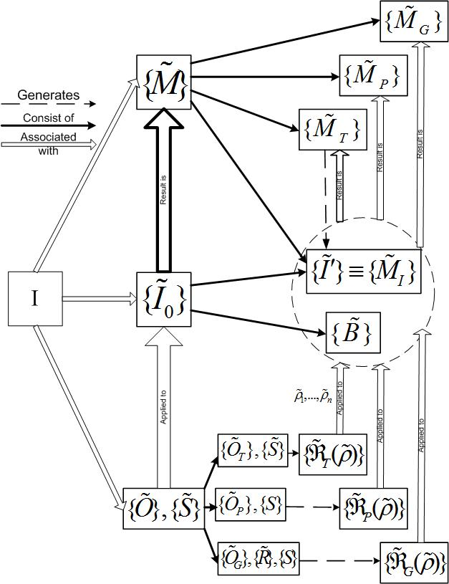

Slide 102
Descriptive Image Models
Axioms
An original image
A set of its digital realizations
Contextual and semantic information associated with the methods used for image recording and formation or with some specific aspects of the image
102 /140

Slide 103
Descriptive Image Models
Axioms
103 /140

Slide 104
Descriptive Image Models
Axioms
Admissible image transformations
Parametric Transformations
Procedural Transformations
Generating Transformations
104 /140

Slide 105
Descriptive Image Models
Axioms
105 /140

Slide 106
Descriptive Image Models
Construction of an Image Model
106 /140

Slide 107
Tutorial Contents
1. State of the art of mathematical theory of image analysis.
2. The Algebraic Approaches and Techniques in Image Analysis. Algebraization of Pattern Recognition (1970 – till now).
2.1 The Basic Theories
2.2 Image Algebras
3. Descriptive Approach to Image Analysis and Understanding (DAIA) and its main tools
3.1 Descriptive Approaches – basic steps
3.2 DAIA
4. Descriptive Model of an Information Technology for Early Diagnostic Analysis of Cytological Specimens
3.3 Descriptive Image Models
4.1 Problem Set-up
4.2 Mathematical Means Used for Formal Representation of a Descriptive Model
4.3Discussion of the Results
107 /140

Slide 108
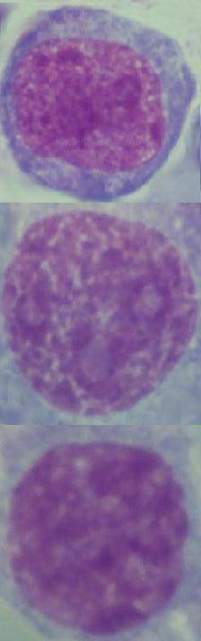
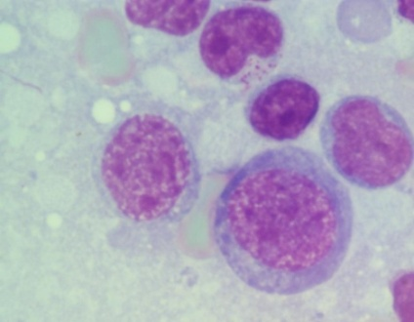
Descriptive Model of an Information Technology
Descriptive Model of an Information Technology for Early Diagnostic Analysis of Cytological Specimens
This part demonstrates application of the descriptive techniques in an application problem - automating of morphologic analysis of cytological specimens (lymphatic system tumors).
De novo large and mixed cell lymphomas (CL)
Transformed chronic lymphatic leukemia (TCLL)
Indolent chronic lymphatic leukemia (CLL)
108 /140

Slide 109
Descriptive Model of an Information Technology
Descriptive Model of an Information Technology for Early Diagnostic Analysis of Cytological Specimens
Problem set-up
Mathematical means used for formal representation of a descriptive model of an information technology for early diagnostic analysis of cytological specimens
Discussion of the results
109 /140

Slide 110
Tutorial Contents
Problem Set-Up
110 /140

Slide 111

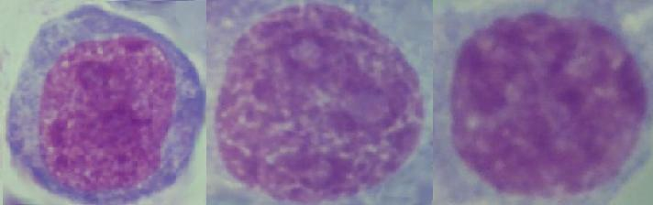
Medical Application. Problem Set-Up
Descriptive Model of an Information Technology for Early Diagnostic Analysis of Cytological Specimens
de novo large and mixed cell lymphomas
Diagnosis | Patient amount | Image amount | Nuclei amount
CL | 18 | 1406 | 1639
TCLL | 12 | 536 | 1025
CLL | 13 | 308 | 2497
Total: | 43 | 1830 | 5161
transformed chronic lymphatic leukemia
indolent chronic lymphatic leukemia
111 /140

Slide 112
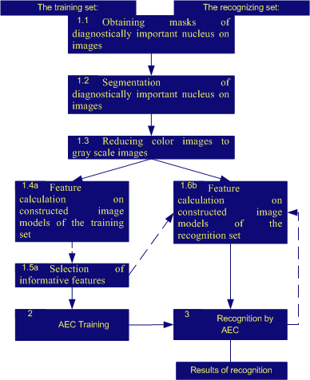

Slide 113
Tutorial Contents
Mathematical means used for formal representation of a descriptive model of an information technology
113 /140

Slide 114
Mathematical means. Descriptive Image Algebras
 | Ring elements | Ring operations | Purpose
1 | color images | standard algebraic operations | To get description of initial images
2 | gray scale images | standard algebraic operations | To get description of separated nucleus on images
3 | operations reducing color images to gray scale images | standard algebraic operations | To eliminate luminance and color differences of images
4 | operations of image feature calculation | standard algebraic operations | To calculate feature values
5 | P-models | image algebra operations | To select the informative features
6 | P-models | standard algebraic operations | To reduce image to a recognizable form
114 /140

Slide 115
Mathematical means. Descriptive Image Groups
 | Group elements | Group operations | Purpose
1 | operations of obtaining the binary mask corresponds indicated lymphocyte cell nuclei | sequential operations for obtaining a binary masks and their addition and multiplication | To describe segmentation process
2 | binary masks corresponds indicated lymphocyte cell nuclei | algebraic operations of union and intersection | To describe binary masks
115 /140

Slide 116
Mathematical means. Descriptive Image Models
 | Name | Purpose of Introduction
1 | Procedural DIM 1 | description of indicated masks of diagnostically important nuclear on images
2 | Procedural DIM 2 | description of indicated diagnostically important nuclear on images
3 | Procedural DIM 3 | representation of indicated diagnostically important nuclear on images by grey-scale images
4 | Parametric DIM 1 | description of diagnostically important nuclear as feature vector
5 | Parametric DIM 2 | Reduction of feature vector dimension
116 /140

Slide 117
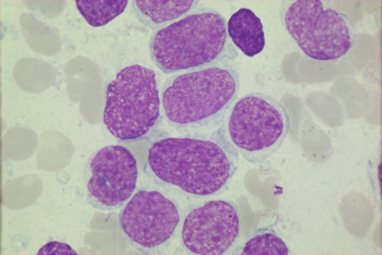
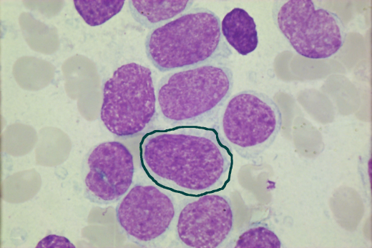

Medical Application. Implementation
Step 1.1. Obtaining masks of diagnostically important nucleus on images
Application of segmentation algorithm is described by operands sb((U,C)→U')∈B of DIG1. An algorithm sb((U,C)→U')∈B is applied to initial images in order to obtain corresponding mask.
117 /140

Slide 118
Medical Application. Implementation
Step 1.1. Obtaining masks of diagnostically important nucleus on images
Description of the procedures :
Step operation is an operation described by DIG1. Such description gives flexibility for using different kind of segmentation algorithms. The applied algorithm of threshold segmentation was supplemented by morphological processing of derivable nuclei images in order to obtain a corresponding mask.
Results of operation applying are binary masks
represented as operands of DIG2.
118 /140

Slide 119

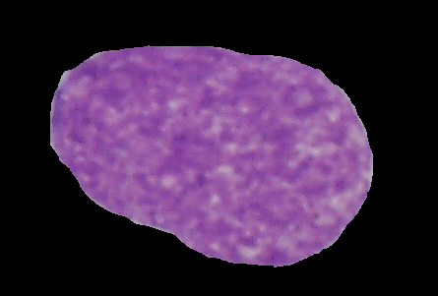
Medical Application. Implementation
Step 1.2. Segmentation of diagnostically important nucleus on images
The contours of indicated by experts lymphocyte cell nucleus were defined on images of cytological specimens. The applied algorithm of threshold segmentation was supplemented by morphological processing of nuclei images in order to obtain a corresponding mask. The mask multiplication by initial image gives indicated nuclei image.
119 /140

Slide 120
Medical Application. Implementation
Step 1.2. Segmentation of diagnostically important nucleus on images
Description of the procedures :
Step operands are initial images and binary masks represented as operands of DIG2.
Step operation is an operation of multiplication of 2 operands of DIA1. All initial images were multiplied by corresponding binary masks.
The results of the operation are T(transfomatonal)-models
120 /140

Slide 121
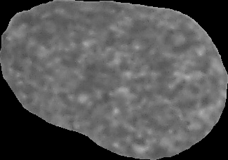
Medical Application. Implementation
Step 1.3. Reducing color images to gray scale images
To compensate different illumination conditions and different colors of stain the specimen images were processed before feature values calculation.
I={{(r(x,y), g(x,y), b(x,y))}_{(x,y) ∈X}}
J={{grey(x,y)}_{(x,y) ∈X}}
gray(x,y)=g(x,y)
R is an average brightness of a red component of an initial RGB-image. The green tone in this case is the most informative.
121 /140

Slide 122
Medical Application. Implementation
.
Step 1.3. Reducing color images to gray scale images
Description of the procedures :
Step operands are image models .
Step operations are described by the elements of the DIA 2. Such representation gives flexibility for using different kinds of processing operations.
The results of the operation are T-models.
122 /46
122 /140

Slide 123
Medical Application. Implementation
Step 1.4a. Feature calculation on constructed image models of the training set.
To calculate different features the training set were processed by different operations of DIA 4 (m₁ equals to a number of segmented nucleus in training set).
To describe each image 47 features were selected:
the size of nucleus in pixels
4 statistical features calculated on the histogram of nucleus intensity
16 granulometric and 26 Fourier features of nucleus.
123 /140

Slide 124
Medical Application. Implementation
Step 1.4a. Feature calculation on constructed image models of the training set.
Description of the procedures :
Step operands are image models
Step operations are described by the elements of DIA 4. Such representation gives flexibility for calculation of different features in order to obtain different P-models
The results of the operation are P-models
124 /140

Slide 125
Medical Application. Implementation
Step 1.5a. Selection of informative features.
The step is an additional step of image model reduction.
As it will be shown below the recognizing algorithm was applied to both full
model and reduced model
At this step the constructed descriptions of images from the training set are studied for selecting the most informative features
Application of factor analysis to training image set detected 14 features with the largest loads in the first and second factor .
125 /140

Slide 126
Medical Application. Implementation
Step 1.5a. Selection of informative features.
Description of the procedures :
The step operands are image models
Step operations are described by the elements of DIA 5. Operations of addition and multiplication are introduced for unificating and for reducing sets of image features to a set of significant features. Operation of multiplication by an element from the field of real numbers is introduced for normalization of feature vectors. Such representation gives flexibility for using different kinds of feature analysis to obtain a reduced set of features. The results of the operation are P-models
126 /140

Slide 127
Medical Application. Implementation
Step 1.6b. Feature calculation on constructed image models of the recognition set.
The steps 1.4a and 1.5a obtain a multi-model representation for training set. The step 1.6b is the step of feature values calculation for a recognition set
Feature calculation (calculation of features of full model
or reduced model for recognition set (j=m1+1,…n)).
Note that multi-model representation of images
was constructed.
127 /140

Slide 128
Medical Application. Implementation
Step 1.6b. Feature calculation on constructed image models of the recognition set.
Description of the procedures :
Step operands are image models.
Step operations are described by the elements of DIA 4. To describe each image 47 or 14 features were selected.
The results of the operation are P-models
128 /140

Slide 129
Medical Application. Implementation
Step 2,3. Algorithms Based on Estimate Calculations
The image feature description
Recognizing
operator B
The vectors of estimates for a class
Decision
rule C
The information vector
129 /140

Slide 130
Medical Application.
Medical Application. Discussion of the results
Algorithmic Scheme
We described the main steps and elements of an algebraic model of information technology for automation of diagnostic analysis of cytological specimens of patient with lymphatic system tumors
130 /140

Slide 131
Medical Application. Discussion of the results
The Recognition Rates for Feature Description
Consisted of 47 features
Diagnosis | The number of correctly recognized cells | Total number of cells | The recognition rate
CL | 693 | 820 | 84,51%
TCLL | 325 | 513 | 63,35%
CLL | 1221 | 1248 | 97,84%
Total cell set | 2239 | 2581 | 86,75%
131 /140

Slide 132
Medical Application. Discussion of the results
The Recognition Rates Using Reduced Feature
Description Consisted of 14 Features
Diagnosis | The number of correctly recognized cells | Total number of cells | The recognition rate
CL | 626 | 820 | 76,35%
TCLL | 300 | 513 | 58,48%
CLL | 1221 | 1248 | 97,84%
Full cell set | 2147 | 2581 | 83,18%
132 /140

Slide 133
Medical Application. Discussion of the results
Main Results
An example of a model for automated diagnostic analysis of cytological specimens
A scheme for implementation of the model
Test of the scheme on specimens:
  good recognition rates
  after reducing the feature set to 14 features obtained by factor analysis the recognition rate decreased to 83,18%
133 /140

Slide 134
Tutorial Conclusion
Tutorial Conclusion
134 /140

Slide 135
Tutorial Conclusions
The DTIA Answer to Image Mining Challenge
Critical points of an applied image-mining problem solving
Precise setting of a problem
Correct and “computable” representation of raw and processed data for each algorithm at each stage of processing
Automated selection of an algorithm
Performance evaluation at each step of processing and of the solution
135 /140

Slide 136
Tutorial Conclusions
The DTIA Answer to Image Mining Challenge
Automated Selection of an Algorithm
Decomposition of the solution process for main stages
Indication of the points of potential improvement of the solution (“branching points”)
Collection and application of problem solving experience
Selection for each problem solution stage of basic algorithms, basic operations and basic models (operands)
Classification of the basic elements
136 /140

Slide 137
Tutorial Conclusions
The DTIA Answer to Image Mining Challenge
Performance evaluation at each step of processing and of the solution
Analysis, estimation and utilization of the raw data specificity
Diversification of mathematical tools used for performance evaluation
Reduction of raw data to the real requirements of the selected algorithms
137 /140

